Slide 1
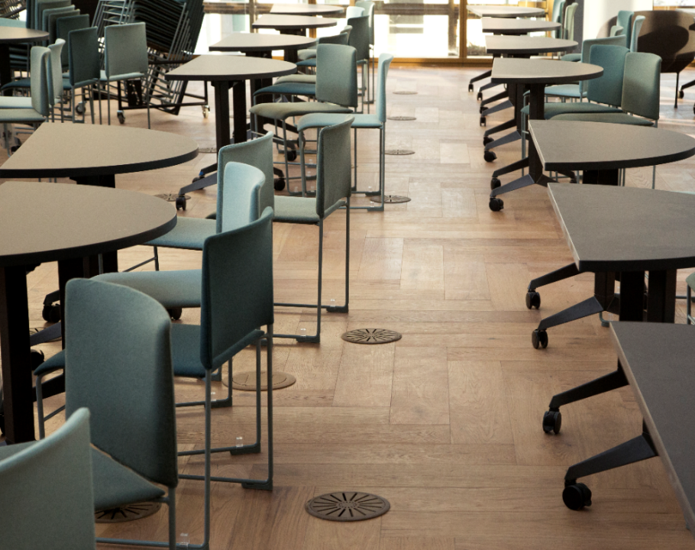


Finish Guide
2025

Slide 2

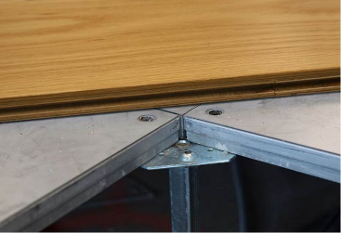

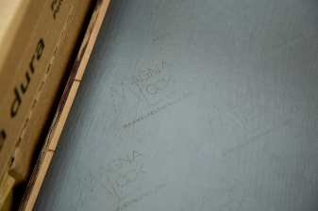
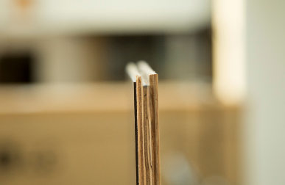
What is Magna-Lock?
Global IFS Magna-Lock Finish Selections
Magna-Lock is a magnetic flooring system specifically designed for use on raised access flooring systems. This innovative, cutting edge system allows high-end finishes to be directly attached to the raised access floor while allowing for easy access to underfloor components. Designers have complete flexibility to bring their vision to life with many finishes including an uncompromising selection of wood, terrazzo and luxury vinyl tile (LVT) finishes, manufactured by world-class flooring companies. With Magna-Lock you are expanding the possibilities to take your space to the next level.

Slide 3
How Do I Get a Magna-Lock Quote?
Global IFS Magna-Lock Finish Selections
Questions that need to be answered:
Supplier name
Collection
Colorway
Length
Width
Finish (if applicable)

Slide 4
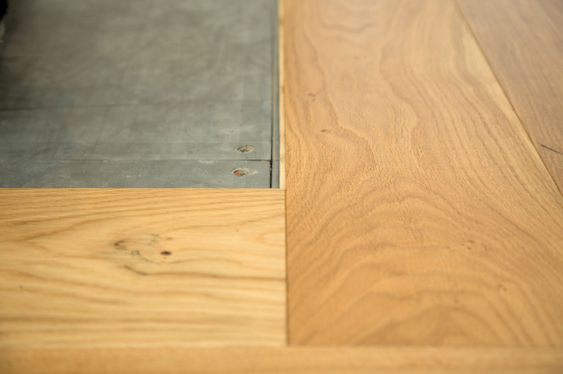
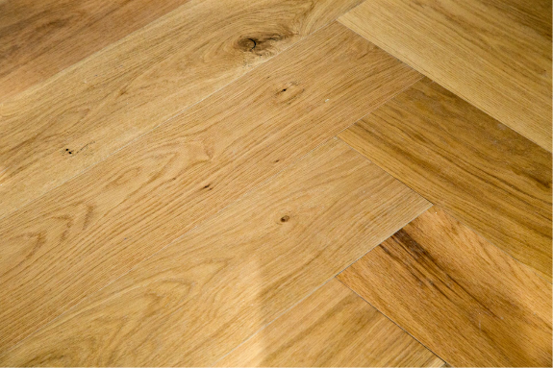

Engineered Hardwood
Global IFS Magna-Lock Finish Selections

Slide 5
Engineered Hardwood- Northern Wide Plank
Global IFS Magna-Lock Finish Selections

Slide 6
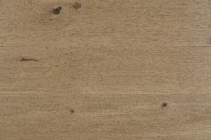
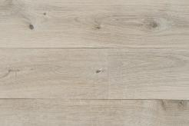
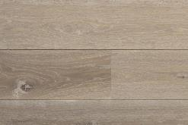
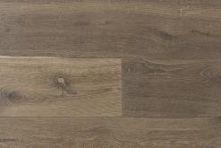
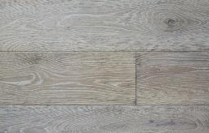
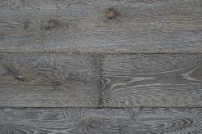
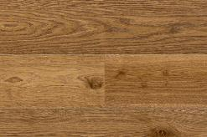
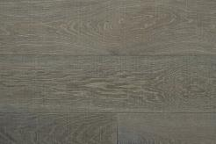
WIXOM COLLECTION - European Oak https://northernwideplank.com/collections/wixom
Global IFS Magna-Lock Finish Selections – Northern Wide Plank Engineered Hardwood
New Haven
Dover
Edinburgh
Greyson
Steppe
Storm
Gallant
Nordic

Slide 7
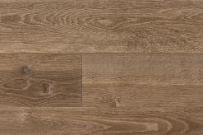
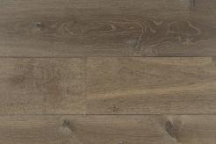
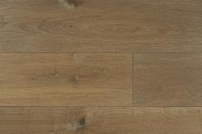
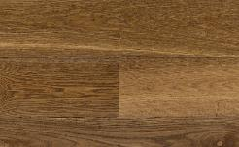
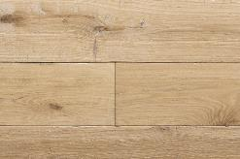
WIXOM COLLECTION - European Oak https://northernwideplank.com/collections/wixom
Global IFS Magna-Lock Finish Selections – Northern Wide Plank Engineered Hardwood
Tide
Stoneham
Tundra
Kensington
Whitecliff

Slide 8
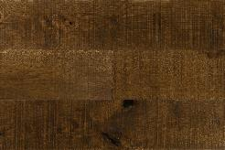
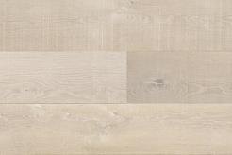
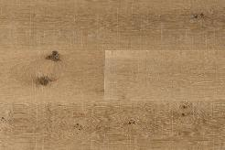
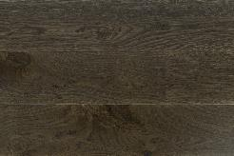
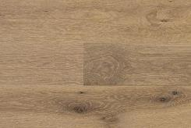
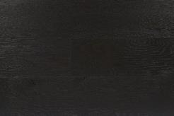
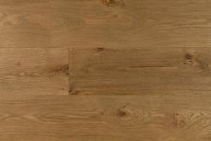
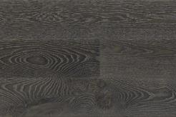
ICONIC White Oak Wide Plank Collection https://northernwideplank.com/collections/iconic
Global IFS Magna-Lock Finish Selections – Northern Wide Plank Engineered Hardwood
Eldorado
Montauk
Ventura
Biscayne
Solstice
Blackstone
Boulder
Breckenridge

Slide 9
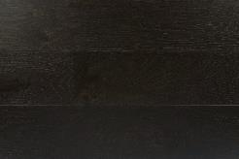
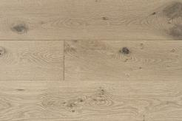
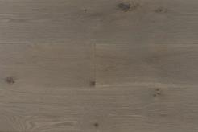
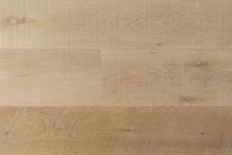
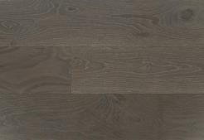
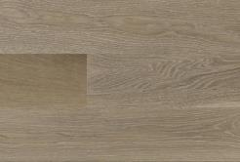
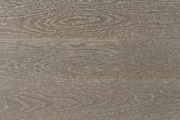
ICONIC White Oak Wide Plank Collection https://northernwideplank.com/collections/iconic
Global IFS Magna-Lock Finish Selections – Northern Wide Plank Engineered Hardwood
Burnt Hills
Del Mar
Hampton
Palomar
Sequoia
Shore
Tremblant

Slide 10
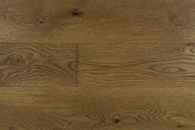
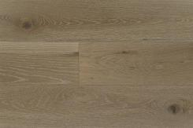
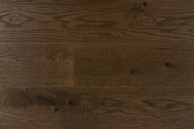
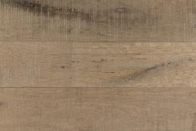
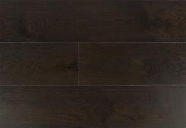
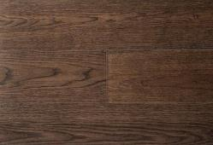
ICONIC White Oak Wide Plank Collection https://northernwideplank.com/collections/iconic/white-oak?sort_by=
Global IFS Magna-Lock Finish Selections – Northern Wide Plank Engineered Hardwood
Baffin
Cumberland
Denali
Gaspe
Hopewell
Kluane

Slide 11
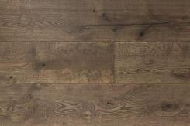
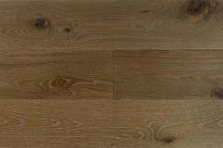
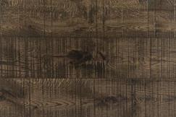
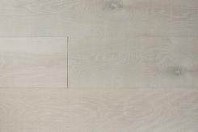
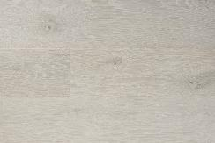
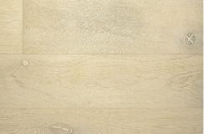
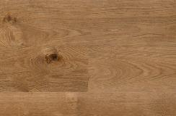
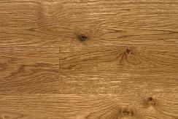
ICONIC White Oak Wide Plank Collection https://northernwideplank.com/collections/iconic
Global IFS Magna-Lock Finish Selections – Northern Wide Plank Engineered Hardwood
Muskoka
Yosemite
Rainier
Cod
Whiteface
Sable
Sedona
Berkshire

Slide 12
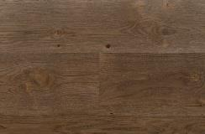
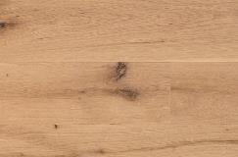






ICONIC White Oak Wide Plank Collection https://northernwideplank.com/collections/iconic
Global IFS Magna-Lock Finish Selections – Northern Wide Plank Engineered Hardwood
Napa
Juneau
Revelstoke
Boulder
Sierra
Montara
Laguna
Cape Cod

Slide 13

Engineered Hardwood- Nydree
Global IFS Magna-Lock Finish Selections

Slide 14






Plain Sawn White Oak https://nydreeflooring.com/products/plainsawn-white-oak-hardwood
Global IFS Magna-Lock Finish Selections – Nydree Engineered Hardwood
Natural
Antique Barrel
Black Forest
Perfect Brown
Pineapple
Slightly Blue

Slide 15




Plain Sawn White Oak https://nydreeflooring.com/products/plainsawn-white-oak-hardwood
Global IFS Magna-Lock Finish Selections – Nydree Engineered Hardwood
Sweet Honey
Winter Sky
Sun Bleached
Graystone

Slide 16






Maple https://nydreeflooring.com/products/maple-hardwood
Global IFS Magna-Lock Finish Selections – Nydree Engineered Hardwood
Natural
Black Forest
Graystone
Perfect Brown
Sun Bleached
Winter Sky

Slide 17







Ash https://nydreeflooring.com/products/ash-hardwood
Global IFS Magna-Lock Finish Selections – Nydree Engineered Hardwood
Natural
Black Forest
Graystone
Winter Sky
Perfect Brown
Sun Bleached
Vanilla

Slide 18






Walnut https://nydreeflooring.com/products/walnut-hardwood
Global IFS Magna-Lock Finish Selections – Nydree Engineered Hardwood
Natural
Antique Barrel
Black Forest
Sweet Honey
Sun Bleached
Graystone

Slide 19
Engineered Hardwood- Mannington
Global IFS Magna-Lock Finish Selections

Slide 20







Park City Collection https://www.mannington.com/Residential/Hardwood/Hand-Crafted/Latitude-Park-City/HPLV07SUD1
Global IFS Magna-Lock Finish Selections – Mannington Engineered Hardwood
Alpine
Olympic
Snowcap
Natural
Summit
Sundance
Wintry

Slide 21





Prospect Park Collection https://www.mannington.com/Residential/Hardwood/Hand-Crafted/Latitude-Prospect-Park/HPLV07ARC1
Global IFS Magna-Lock Finish Selections – Mannington Engineered Hardwood
Arch
Breeze
Stone
Trail
Amber
Flaxen

Slide 22




Normandy Oak Collection https://www.mannington.com/Residential/Hardwood/Hand-Crafted/Maison-Normandy/MSN07BRU1
Global IFS Magna-Lock Finish Selections – Mannington Engineered Hardwood
Brandy
Brioche
Bistro
Brulee

Slide 23

Bastille Collection https://www.mannington.com/Residential/Hardwood/Hand-Crafted/Maison-Bastille/MSB07TA1
Global IFS Magna-Lock Finish Selections – Mannington Engineered Hardwood
Tawny

Slide 24




Provence Collection https://www.mannington.com/Residential/Hardwood/Hand-Crafted/Maison-Provence/MSP07VIN1
Global IFS Magna-Lock Finish Selections – Mannington Engineered Hardwood
Champagne
Vine
Wine Barrel
Blanc

Slide 25

Smokehouse Hickory Collection https://www.mannington.com/Residential/Hardwood/Hand-Crafted/Maison-Smokehouse-Hickory/SMKH07EM1
Global IFS Magna-Lock Finish Selections – Mannington Engineered Hardwood
Ember

Slide 26

Smokehouse Oak Collection https://www.mannington.com/Residential/Hardwood/Hand-Crafted/Maison-Smokehouse-Oak/SMKK07CHRL1
Global IFS Magna-Lock Finish Selections – Mannington Engineered Hardwood
Charcoal

Slide 27

Smokehouse Maple Collection https://www.mannington.com/residential/products/hardwood/hardwood/hardwood-wood-plank/Smokehouse%20Maple/SMKM07FUM1
Global IFS Magna-Lock Finish Selections – Mannington Engineered Hardwood
Fumed

Slide 28






Triumph Collection https://www.mannington.com/Residential/Hardwood/Hand-Crafted/Maison-Triumph/TRP07SLV1
Global IFS Magna-Lock Finish Selections – Mannington Engineered Hardwood
Platinum
Gold
Silver
Raw
Copper
Bronze

Slide 29








Sanctuary Collection https://www.mannington.com/Residential/Hardwood/Hand-Crafted/Sanctuary/SANC10DNE1
Global IFS Magna-Lock Finish Selections – Mannington Engineered Hardwood
Fresh Air
Driftwood
Dune
Fireside
Oyster
Seasalt
Shell
Meadow

Slide 30




Sanctuary Collection https://www.mannington.com/Residential/Hardwood/Hand-Crafted/Sanctuary/SANC10DNE1
Global IFS Magna-Lock Finish Selections – Mannington Engineered Hardwood
Moonlight
Mountaintop
Treehouse
Wildflower

Slide 31


Luxury Vinyl Tile
Global IFS Magna-Lock Finish Selections

Slide 32

Luxury Vinyl Tile
Global IFS Magna-Lock Finish Selections

Slide 33










Mixed Monolith Collection/Edge https://www.manningtoncommercial.com/products/hard-surface/amtico-signature/edge/
Global IFS Magna-Lock Finish Selections – Mannington LVT
Balance
Clarity
Composition
Contour
Foundation
Gravity
Honest
Intent
Light
Repose

Slide 34






Mixed Monolith Colllection/Poured https://www.manningtoncommercial.com/products/hard-surface/amtico-signature/poured/
Global IFS Magna-Lock Finish Selections – Mannington LVT
Composition
Contour
Foundation
Gravity
Light
Repose

Slide 35










Mixed Monolith Collection/Scored https://www.manningtoncommercial.com/products/hard-surface/amtico-signature/scored/
Global IFS Magna-Lock Finish Selections – Mannington LVT
Balance
Clarity
Composition
Contour
Foundation
Gravity
Honest
Intent
Light
Repose

Slide 36



Access Collection/Abstract https://www.manningtoncommercial.com/products/hard-surface/amtico-signature/access-abstract/
Global IFS Magna-Lock Finish Selections – Mannington LVT
Linen Weave
Urban Line Felt
Equator Wave

Slide 37







Access Collection/Stone https://www.manningtoncommercial.com/products/hard-surface/amtico-signature/access-stone/
Global IFS Magna-Lock Finish Selections – Mannington LVT
Ceramic Light
Ceramic Flint
Ceramic Dark
Ceramic Ecru
Linear Stone Shale
Linear Stone Black
Dry Stone Clay

Slide 38










Access Collection/Wood https://www.manningtoncommercial.com/products/hard-surface/amtico-signature/access-wood/
Global IFS Magna-Lock Finish Selections – Mannington LVT
Traditional Oak
Bleached Elm
Black Walnut
Dusky Walnut
Ashdown Plum
Winter Oak
Shadow Oak
Frosted Oak
Shibori Jasmine
Simple Beech

Slide 39





Memory https://www.bentleymills.com/product/memory/
Global IFS Magna-Lock Finish Selections – Bentley Mills LVT
Craftsman
Prairie
Mission
Bungalow
Foursquare

Slide 40





Moment https://www.bentleymills.com/product/moment/
Global IFS Magna-Lock Finish Selections – Bentley Mills LVT
Organic
Minimalist
Form
Function
Asymmetric

Slide 41





Mood https://www.bentleymills.com/product/mood/
Global IFS Magna-Lock Finish Selections – Bentley Mills LVT
Passive
Sustainable
Open
Fluid
Integrated

Slide 42






Batiste https://www.bentleymills.com/product/batiste/
Global IFS Magna-Lock Finish Selections – Bentley Mills LVT
Cambric
Chambray
Cotton
Greige
Linen
Opaque

Slide 43




Batiste https://www.bentleymills.com/product/batiste/
Global IFS Magna-Lock Finish Selections – Bentley Mills LVT
Thread
Warp
Weave
Weft

Slide 44








Fortified Foundations –LVT - 5.0mm Loose Lay Fortified Foundations Color Options
Global IFS Magna-Lock Finish Selections – Milliken LVT
Power Grid- Coastal Gray
Power Grid- Parchment
Power Grid - Graphite
Power Grid- Hemp
Tangible- Dawn
Tangible- Dusk
Terrazzo- Ore
Terrazzo Grit

Slide 45






Fortified Foundations LVT - 5.0mm Polished Concrete Fortified Foundation Color Offering
Global IFS Magna-Lock Finish Selections – Milliken LVT
Power Grid- Pearl
Power Grid- Nickel
Polished Concrete- Reflective
Polished Concrete- Sandpaper
Polished Concrete- Scoring
Polished Concrete- Ambient

Slide 46








Fortified Foundations LVT - 5.0mm - Pike & Shenandoah Fortified Foundations Color Options
Global IFS Magna-Lock Finish Selections – Milliken LVT
Chevron- Flourish
Chevron- Abundance
Chevron- Mesmerize
Chevron- Thrive
Heritage Wood- Legacy
Heritage Wood- Pride
Heritage Wood- Honor
Heritage Wood- Courage

Slide 47








Fortified Foundations LVT - 5.0mm - Pike & Shenandoah Fortified Foundations Color Options
Global IFS Magna-Lock Finish Selections – Milliken LVT
Pike- Antler
Pike-Bark
Pike-Cloud
Pike- Dew
Shenandoah- Mist
Shenandoah- Whimsy
Shenandoah- Fog
Shenandoah- Moose

Slide 48








Fortified Foundations LVT - 5.0mm - Pike & Shenandoah Fortified Foundations Color Options
Global IFS Magna-Lock Finish Selections – Milliken LVT
Raw Wood- Earthen
Raw Wood- Sandy
Raw Wood-Light Sandstorm
Raw Wood- Revival
Siberian Larch- Harbor
Siberian Larch- Haven
Siberian Larch- Cove
Siberian Larch- Retreat

Slide 49








Fortified Foundations LVT - 5.0mm – Fargesia Bamboo, Gunnison & Heritage Wood Fortified Foundations Color Options
Global IFS Magna-Lock Finish Selections – Milliken LVT
Siberian Larch-Shelter
Basswood- Honey
Basswood- Vanilla
Basswood- Walnut
Heritage- Courage
Heritage- Honor
Heritage- Legacy
Heritage- Pride

Slide 50


Terrazzo
Global IFS Magna-Lock Finish Selections

Slide 51
Terrazzo
Global IFS Magna-Lock Finish Selections

Slide 52









Trend Origina https://trendterrazzo.com/terrazzo-trend-origina/
Global IFS Magna-Lock Finish Selections – Terrazzo
Orange
Red
White
Diorite
Dark Blue
Night Blue
Blue Dream
Rose

Slide 53









Trend Origina https://trendterrazzo.com/terrazzo-trend-origina/
Global IFS Magna-Lock Finish Selections – Terrazzo
Chiaro Ambra
Polar Ice
Perla Bianca
Perla Di Sabbia
Cinders
Ambercream
Crema Luna
Black Dream

Slide 54








Trend Origina https://trendterrazzo.com/terrazzo-trend-origina/
Global IFS Magna-Lock Finish Selections – Terrazzo
White Star
King Ivory
Pietra Serena
Bianco Modena
Sparkling Black
Terra Ombra
Navy Blue
Perla Di Modena

Slide 55








Trend Origina https://trendterrazzo.com/terrazzo-trend-origina/
Global IFS Magna-Lock Finish Selections – Terrazzo
Titan Grey
Terra Di Siena
Tierra Chiarra
Royal Ivory
Gardena
Hydra White
Graphite Luster
Princess

Slide 56










Trend Origina https://trendterrazzo.com/terrazzo-trend-origina/
Global IFS Magna-Lock Finish Selections – Terrazzo
Dove Tail
Black Gold
Ice Gold
Warm White
Royal Grey
Purple Blue
All White
Stormy Grey
Taupe
Musk

Slide 57
Cork
Global IFS Magna-Lock Finish Selections

Slide 58
Cork
Global IFS Magna-Lock Finish Selections
Company | Product Name | Thickness | Width(in) | Length(in) | Line & Color
Amorim- Wicanders Wise | Inspire Natural Wood | 0.335" (8.5mm) | 7.67" (195mm) | 48.29" (1225mm) | Antique Oak Honey, Antique Oak Tobacco, Ariana Oak,Dakota Oak, Dakota Oak Brown, Dakota Oak Greyge, Dakota Oak Sand, Epoca Oak Dark Almond, Essential Oak,Farnia Oak Savannah, Ginger Wood Camel, Nature Oak Almond,Natural Oak Beige, Panama Oak, Panama Oak Cognac, Panama Oak Light Sand
Amorim- Wicanders Wise | Inspire Cork | 0.267" (7mm) | 7.67" (195mm) | 48.29" (1225mm) | Identity Moonlight, Identity Chestnut, Traces Tea, Traces Spice, Traces Jasmin, Shell Marfim, Orignals Shell, Orignals Harmony, Fashionable Cement, Fashionable Grafite

Slide 59






Inspire Natural Wood
Global IFS Magna-Lock Finish Selections – Wicanders Cork
Antique Oak Honey
Antique Oak Tobacco
Ariana Oak
Dakota Oak
Dakota Oak Brown
Dakota Oak Greyge

Slide 60






Inspire Natural Wood
Global IFS Magna-Lock Finish Selections – Wicanders Cork
Dakota Oak Sand
Epoca Oak Dark Almond
Essential Oak
Farnia Oak Savannah
Ginger Wood Camel
Natural Oak Almond

Slide 61






Inspire Natural Wood
Global IFS Magna-Lock Finish Selections – Wicanders Cork
Natural Oak Beige
Panama Oak
Pure Oak
Panama Oak Cognac
Panama Oak Light Sand
Pure Oak Grey

Slide 62






Inspire Cork
Global IFS Magna-Lock Finish Selections – Wicanders Cork
Fashionable Cement
Fashionable Graffite
Identity Chestnut
Identity Moonlight
Originals Shell
Originals Harmony

Slide 63




Inspire Cork
Global IFS Magna-Lock Finish Selections – Wicanders Cork
Shell Marfim
Traces Jasmim
Traces Spice
Traces Tea

